Slide 1
prevention-smart parents
An Online Resource for Parents to Protect Their Children from Drug Misuse

Slide 2
Why?
There is a demand and need particularly from developing countries for parents and caregivers to receive further help and support in the field of prevention
The need is to develop human resource capability and expertise
Specifically to enable key 'agents of prevention' to make a meaningful and effective contribution to preventing drug misuse

Slide 3
“
Research shows that parents and caregivers have the greatest influence on their children’s lives and prevention-smart parents focuses directly on providing them the support they need
”

Slide 4
What?
An online e-learning programme consisting of modules developed, monitored and supported by Mentor’s international team of scientific experts
Targeted at parents, caregivers and members of the young person’s extended family
Provides an opportunity to learn the basics of drug misuse prevention through the medium of the Internet
Designed to actively engage users and provide practical resources for parents and caregivers to use at home with their children

Slide 5
Homepage

Slide 6
Chapters
You Are Not Alone!
Why Do Teenagers Act the Way They Do?
What You Need to Know About Drugs
What You Need to Know About Alcohol and Tobacco
What You Need to Know About Cannabis
Why Do Some Kids Use Drugs?
How Do I Protect My Child From Drugs?
Communication, Discipline, and Support
Does Media Make a Difference?
What to Do if My Teenager is Using Drugs

Slide 7
Format
Short 10-15 page chapters
Cartoons and animations featuring ‘Mentor Man’
Straightforward language targeted at parents needs

Slide 8
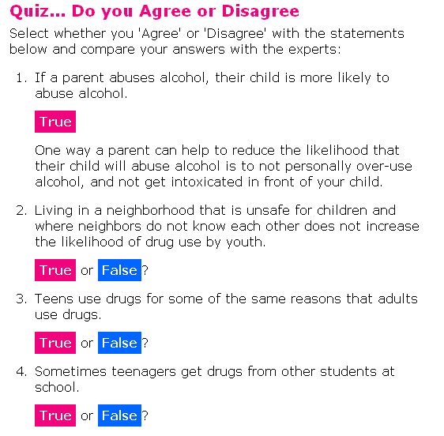
Interactive Learning
Interactive sections help to break up the text
Test your knowledge and intuition with simple quizzes
The ‘correct’ answer is always fully explained

Slide 9
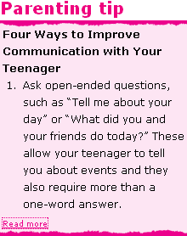
Tips and Activities
Optional ‘Parenting Tips’ and ‘Suggested Activities’ appear in sidebars
Provide more depth for parents who want it without making chapters too long

Slide 10
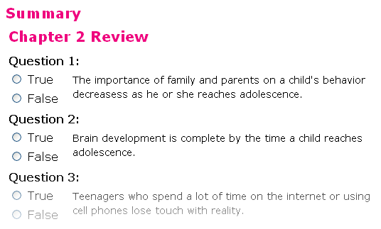
Chapter Summaries
Chapters end with a simple and reassuring summary of the topics covered
Links are provided to other online resources for further reading
There is also an opportunity for parents to test themselves
Certificate for parents who complete all chapter reviews

Slide 11
Community
A forum is provided for parents to discuss the chapters and provide each other with assistance
Site news, updates and interesting emerging prevention science provided via a blog and newsletter for registered users
Potential for translation and localisation by regional partners
Future opportunity for use of social networks and user-generated content

Slide 12
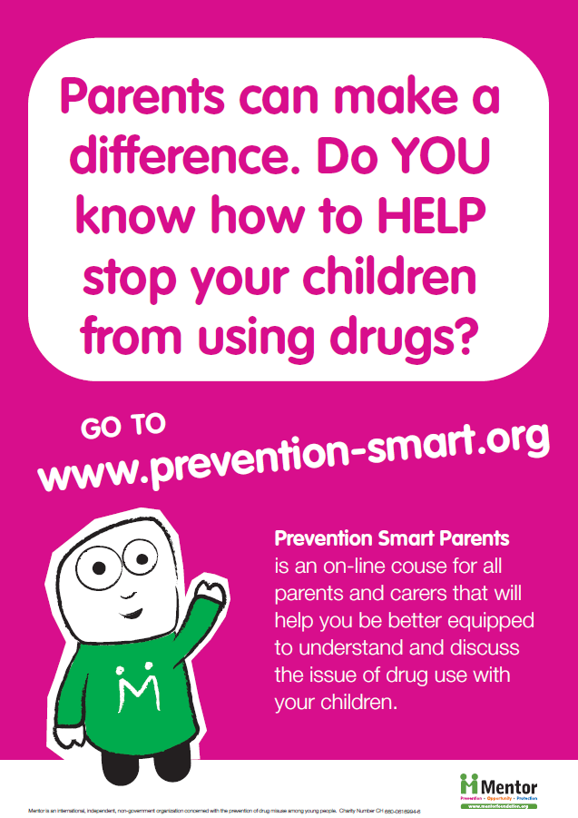
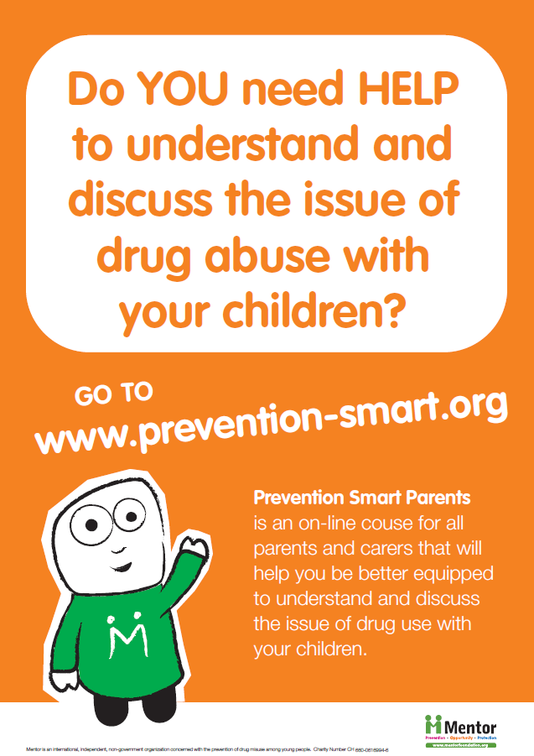

Slide 13
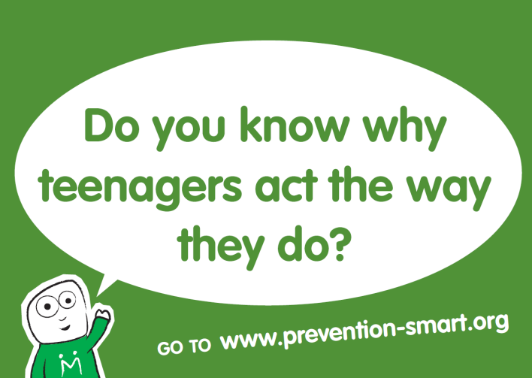
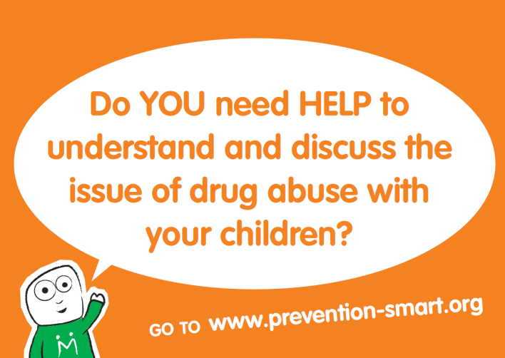
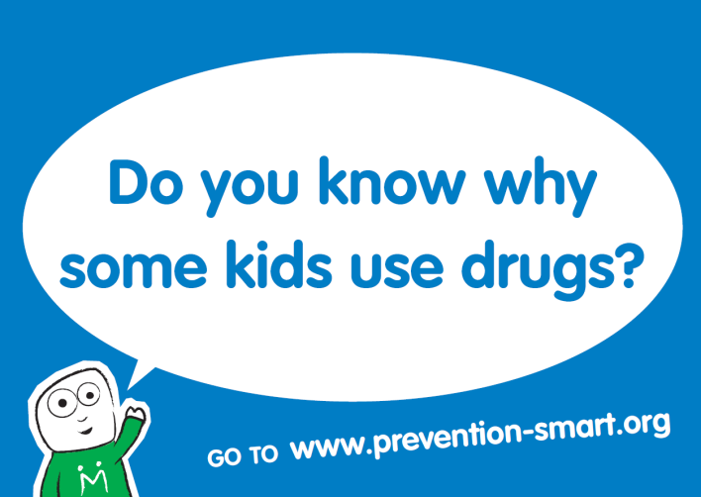
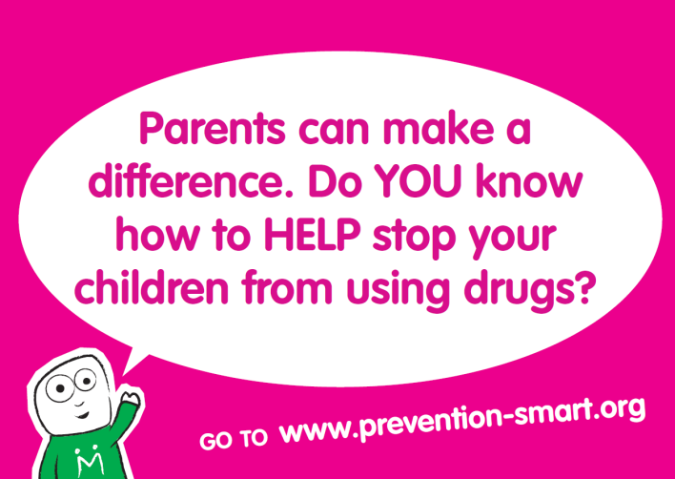

Slide 14
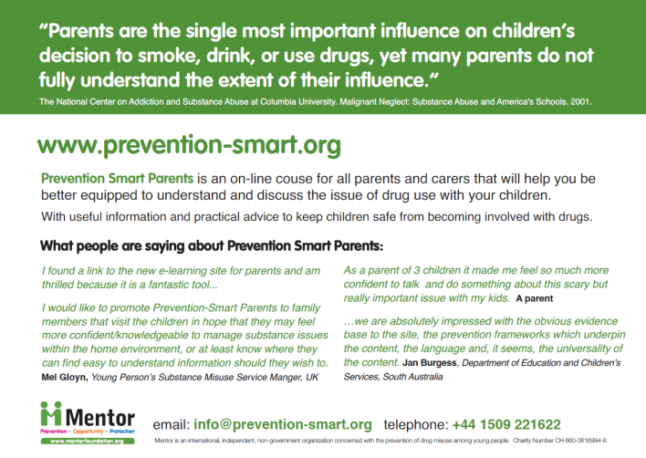

Slide 15
prevention-smart parents
An Online Resource for Parents to Protect Their Children from Drug Misuse
www.prevention-smart.org
Launched 26th June 2009

